Slide 1
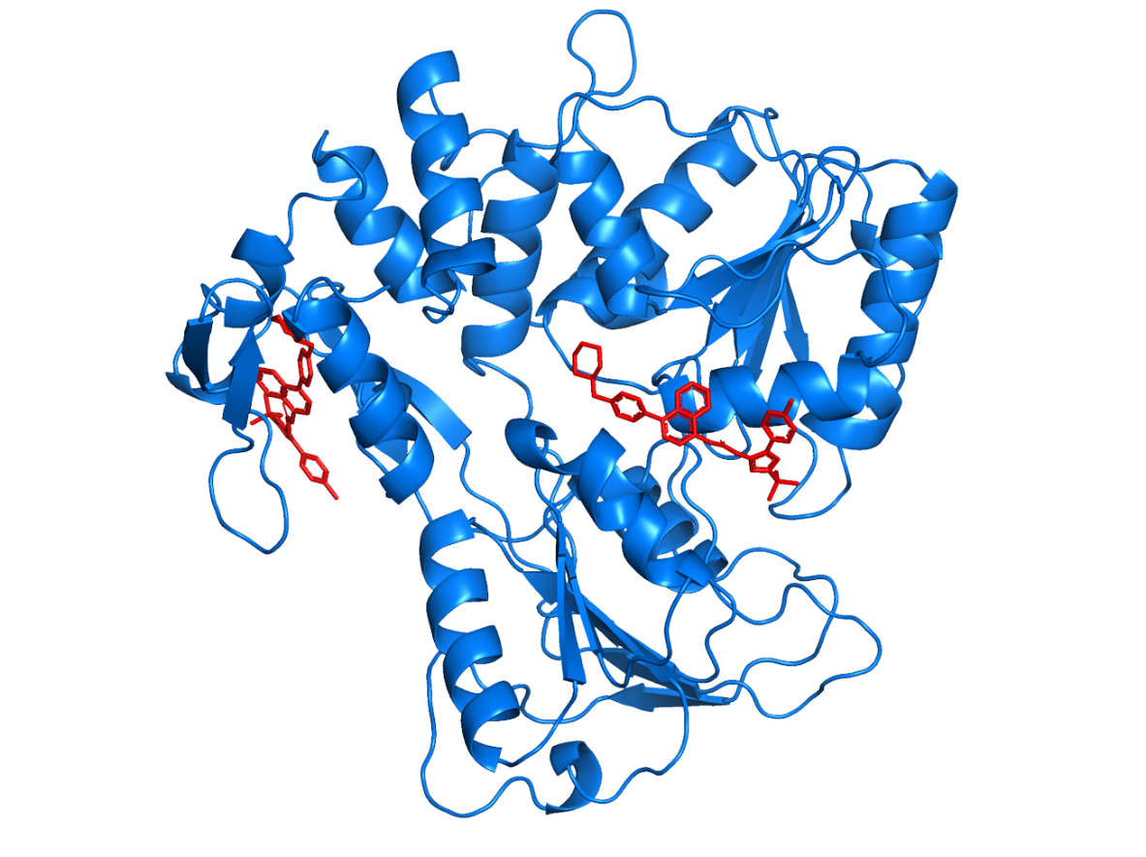
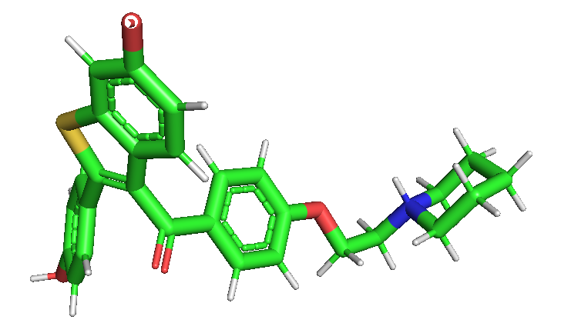
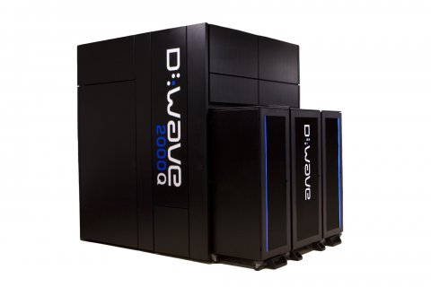



Riccardo Mengoni, Kevin Mato, Daniele Ottaviani, Gianluca Palermo
Molecule Unfolding with Quantum Annealing
HPC and Quantum Computing 2020
15 Dec 2020

Slide 2
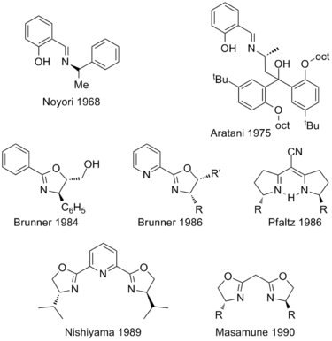
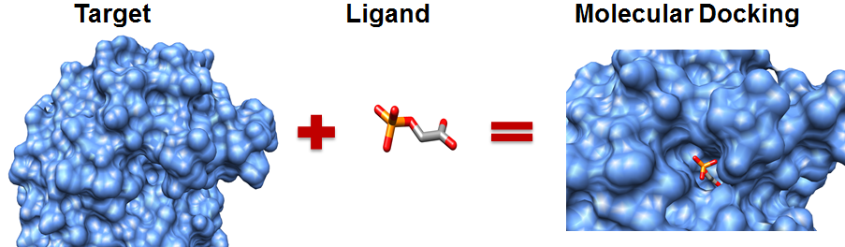
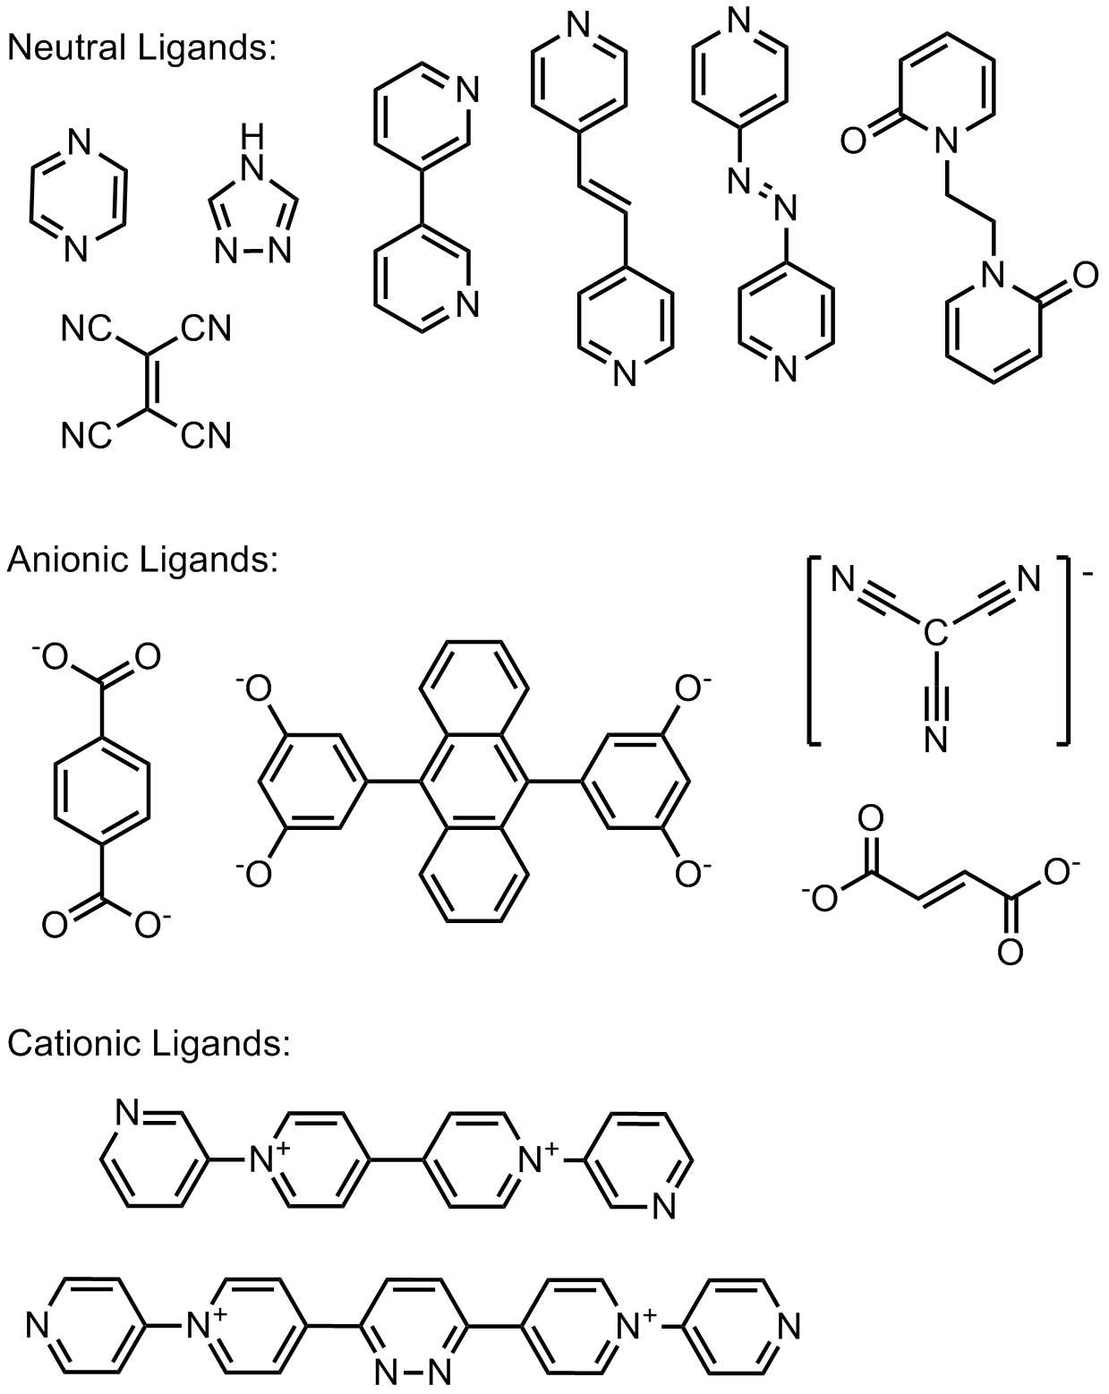
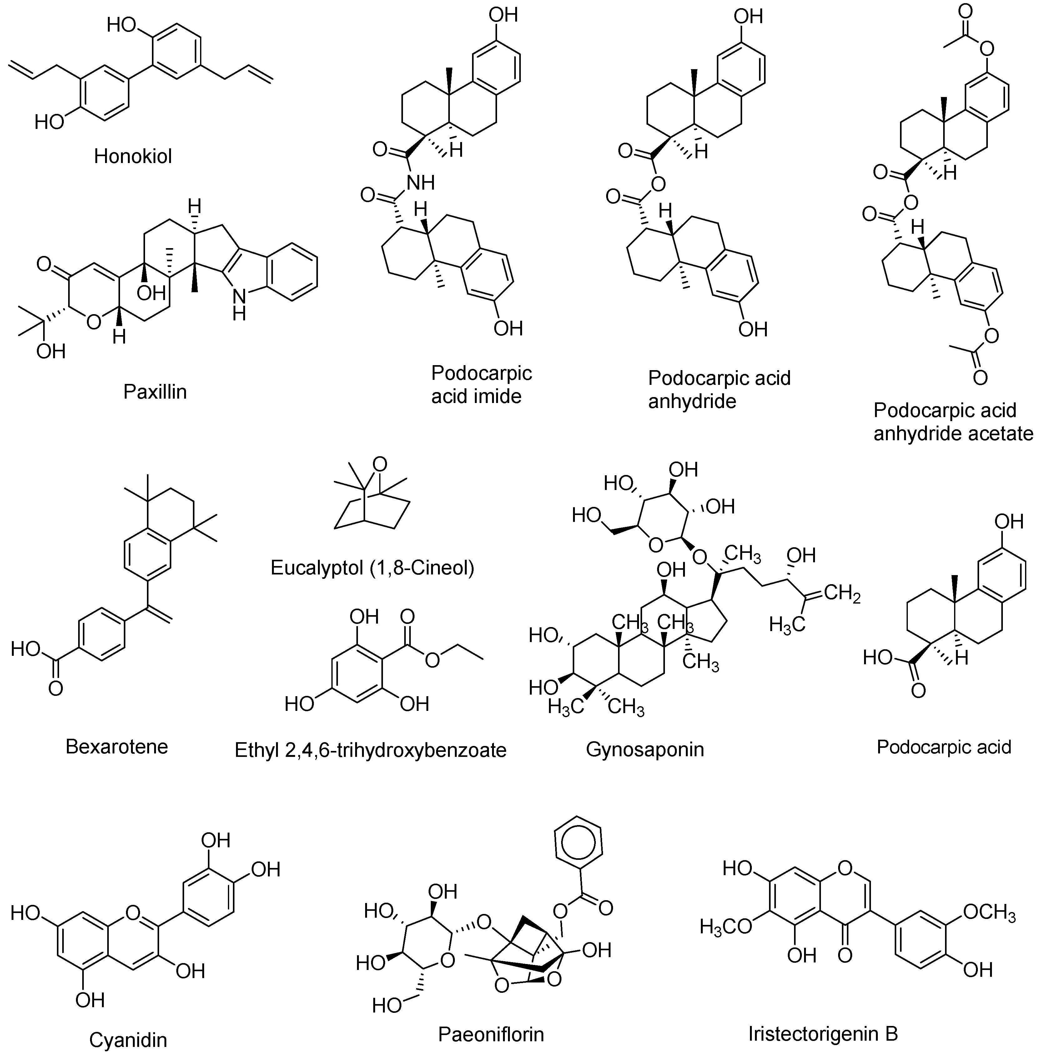
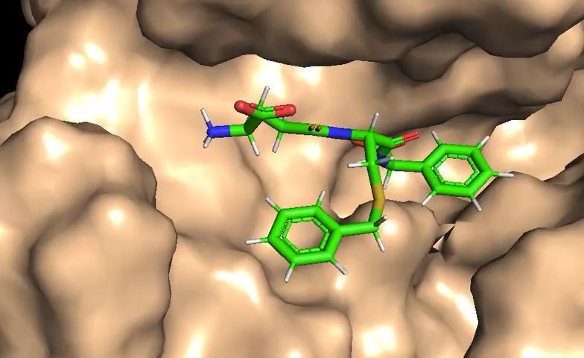


Molecular Docking for Virtual Screening
Tangible Chemical Space: 300 Bio
Molecular docking is a method to calculate the preferred position and shape of one molecule to a second when bound to each other.
Geometrical approaches require
a shape-bias removal.
The initial shape impacts the final docking quality.
This removal takes as much as the docking.
Induced by SMILE-to-3D tools.

Slide 3
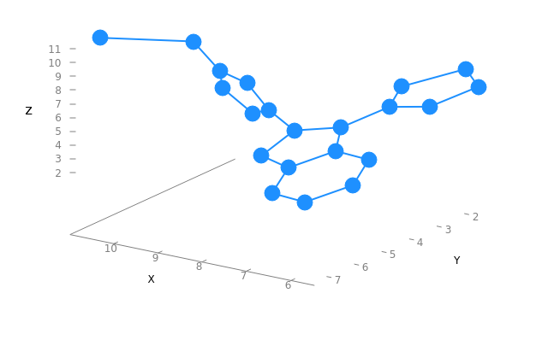

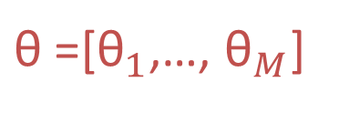
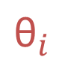
Problem Definition
Objective: find the unfolded torsion configuration that maximizes the molecular volume, or equivalently, that maximizes the distances between fragments.
Set of Rotable Bonds
Fragment_L
Fragment_R
$${\text{θ}}_{i}$$
$\text{θ}$=[${\text{θ}}_{1}$,…, ${\text{θ}}_{M}$]

Slide 4
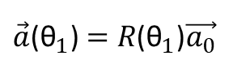
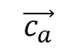
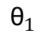
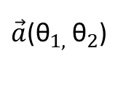
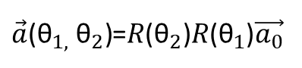
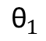
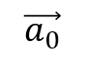
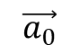
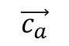
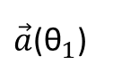
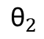
Problem Definition
To each torsion is associated is a rotation matrix R.
$$\vec{a_{0}}$$
$${\text{θ}}_{1}$$
$${\text{θ}}_{2}$$
$${\text{θ}}_{1}$$
$$\vec{a_{0}}$$
$$\vec{c_{a}}$$
$$\vec{c_{a}}$$
$\vec{a}$(${\text{θ}}_{1}$)
$\vec{a}$(${\text{θ}}_{1,}$ ${\text{θ}}_{2}$)
$\vec{a}$(${\text{θ}}_{1}$) $=R\text{(}{\text{θ}}_{1}\text{)}\vec{a_{0}}$
$\vec{a}\text{(}{\text{θ}}_{1,} {\text{θ}}_{2}\text{)}$=$R\text{(}{\text{θ}}_{2}\text{)}R\text{(}{\text{θ}}_{1}\text{)}\vec{a_{0}}$

Slide 5
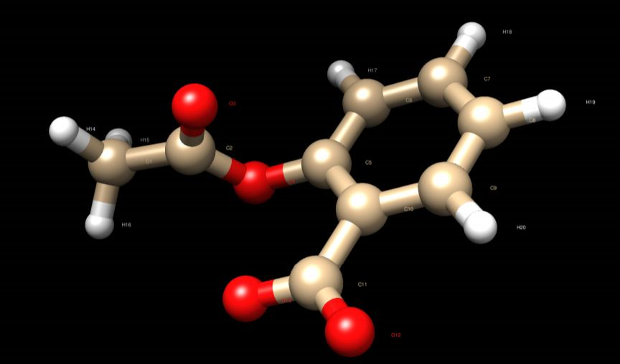
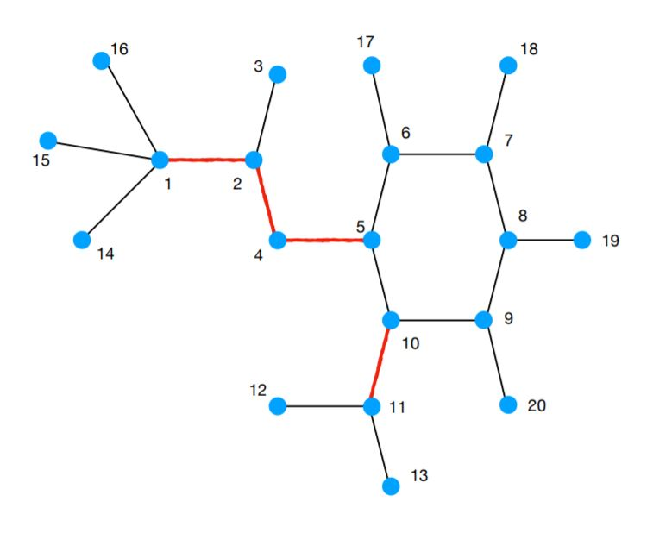
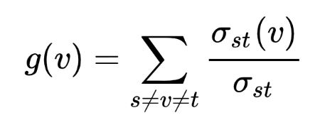
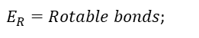
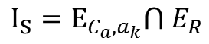
Molecule Unfolding
Betweenness centrality:
Rotables Influence set:
$E_{R}=Rotable bonds$;
$$E_{C_{a},a_{k}}=Bonds on the shortest path σ_{C_{a},a_{k}}$$
${{\text{I}}_{\text{s}}=\text{E}}_{C_{a},a_{k}}⋂$ $E_{R}$
Notes:
Double and amide bonds are not rotable.
Without Hydrogen.

Slide 6
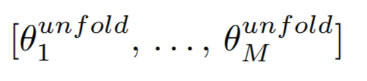
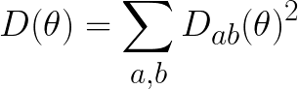
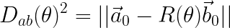
Combinatorial Optimization Problem Definition
Objective: find the unfolded torsion configuration
that maximizes the sum of distances${ D}_{ab}(\text{θ}\text{)}$ between fragments a and b
where

Slide 7
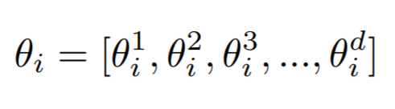
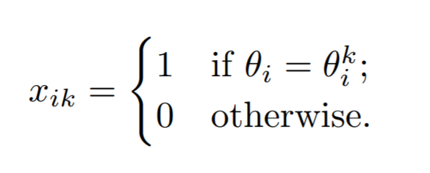
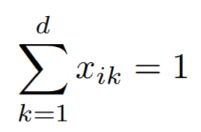
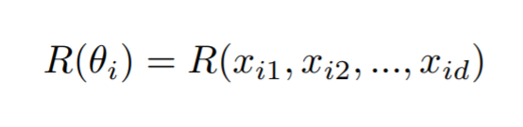
Constructing the High-order Unconstrained Binary Optimization (HUBO) problem
Consider a discretization of the torsion angle ${\text{θ}}_{i}$ into $d$ possible values
And introduce a binary variable $x_{ik}$ with 1 ≤ k ≤ d, such that
with the constraint
With such encoding, the rotation matrix R(${\text{θ}}_{i}$) associated the torsion angle ${\text{θ}}_{i}$ becomes a function of all the binary variables $x_{ik}$ needed to represent the angle ${\text{θ}}_{i}$

Slide 8
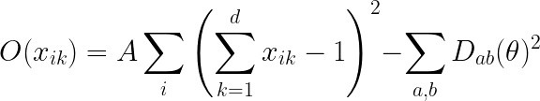
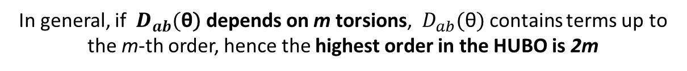
Constructing the High-order Unconstrained Binary Optimization (HUBO) problem
The general form of the HUBO optimization function is
where the pairwise distances are expressed using the binary variables
In general, if ${ D}_{ab}(\text{θ}\text{)}$ depends on m torsions, ${ D}_{ab}(\text{θ}\text{)}$ contains terms up to the m-th order, hence the highest order in the HUBO is 2m

Slide 9
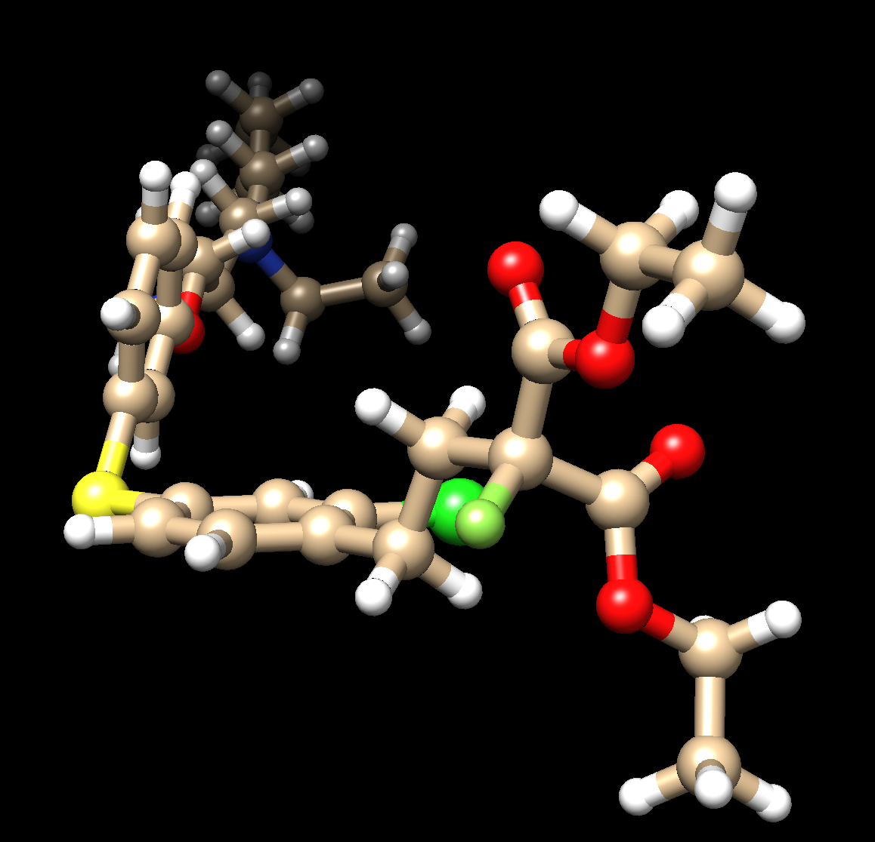
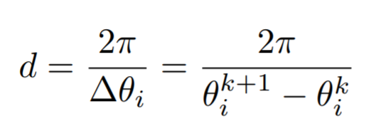
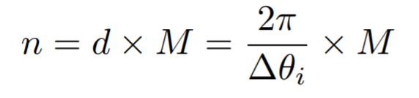
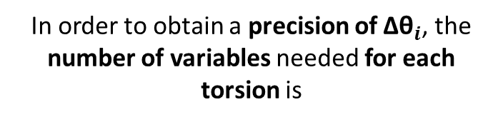
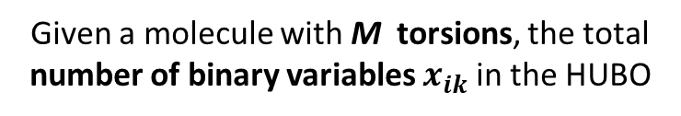
HUBO Problem Structure
In order to obtain a precision of ${\text{∆}\text{θ}}_{i}$, the number of variables needed for each torsion is
82 atoms - 40 fragments - 20 torsions
Given a molecule with M torsions, the total number of binary variables $x_{ik}$in the HUBO

Slide 10
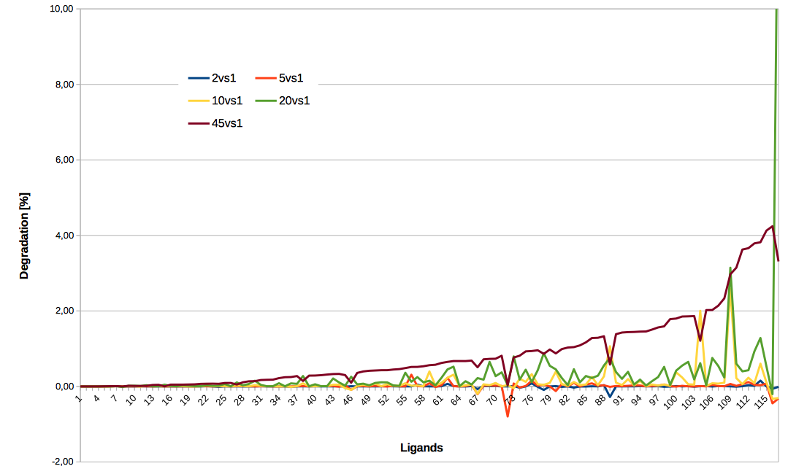
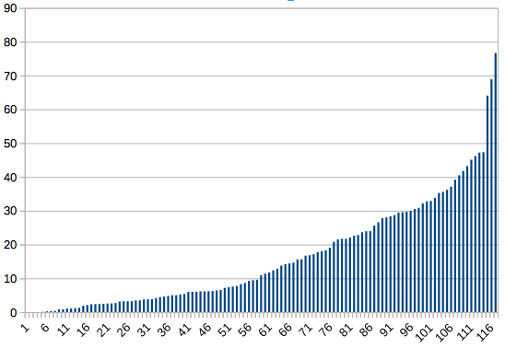
Angle subsampling effect on the unfolding degradation
Granularity Degradation Effect
15%
Unfolded vs Initial
AVG Volume gain
17%

Slide 11
HUBO Problem Structure at ${\text{∆}\text{θ}}_{i}$= $π$/4
HUBO linear terms
HUBO high order terms (Log-scale)
Number of torsionals
Number of torsionals

Slide 12
HUBO Problem Approximation
Full HUBO VS Approximated HUBOs
Number of high-order terms
Delete HUBO terms below a certain threshold T:
Speed up the construction of the HUBOs;
Speed up the transformation of HUBOs into QUBOs (done via dimod.make_quadratic);
Make problem solvable with DW_2000Q and Advantage
Number of torsionals

Slide 13
From ApproxHUBOs to QUBOs
QUBO linear terms
QUBO quadratic terms
Number of binary variables
Number of quadratic terms
Number of torsionals
Number of torsionals

Slide 14
Embeddings DW_2000Q_6 & Advantage
Number of physical qubits variables
AVG maximum chain length
phys. qubits
AVG max len.
Number of torsionals
Number of torsionals

Slide 15
Scaling DW_2000Q_6, Advantage & Classical
Optimal Configuration Volume
Runtime scaling
N-times
Volume
Number of torsionals
Number of torsionals

Slide 16
Conclusions
We tackled the problem of molecular unfolding.
New HUBO and then QUBO formulations that can be solved on DWAVE quantum annealers.
We have observed that by increasing the terms cut-off threshold as the problem size becomes bigger, it becomes possible to embed formulations that couldn’t be otherwise.
Embedding our problems on Advantage, compared to the DW2000Q, cost 52% less in terms of physical qubits and with chains 49.7% shorter.
Advantage performed better in terms of quality, since the percentage difference of Advantage and DW2000Q is 5.91%.
DW2000Q has runtimes in average 2.46 times those of Advantage, and the runtimes growth in average of DW2000Q is 2.68 times that of Advantage, when we increase the size of the problem.

Slide 17
Thanks.

